Slide 1
How Tip Options Shape Tipping Decisions: A Randomized Survey Simulation
Team 1: Linh Le, TzuHsuan Liu, Kang Ni, Shanmathi Sivakumar, Hanchao Tang

Slide 2
Outline
01
02
Introduction
Experimental Design
03
04
Data Processing and Summary Statistics
Methodology
05
06
Results
Business Insight
07
08
Limitations
Conclusion

Slide 3
Research Question:
How does showing higher tip suggestions affect the tip percentage selected in a simulated dine-in restaurant checkout?
H0
Ha
There is no effect of showing higher default tip suggestions on the tip percentage selected.
There is an effect of showing higher default tip suggestions on the tip percentage selected.

Slide 4

Experimental Design
Platform
Scenario
Qualtrics online survey
scripted dining experience; fixed bill $16 Tonkotsu ramen
Flow
Participants
scenario → checkout tip choice → short post-questions
classmates + friends
Final sample
Pilot
N = 81 (after removing preview + incomplete)
7–10 respondents; minor clarity edits

Slide 5
Treatment & Randomization
Control
15% / 18% / 20% + Other/custom
Manipulation
Default tip options on payment screen
Treatment
18% / 20% / 25% + Other/custom
Randomization
Unit: individual respondent
Method: Qualtrics built-in randomizer (intended ~50/50)
Timing: assigned immediately before the payment screen

Slide 6
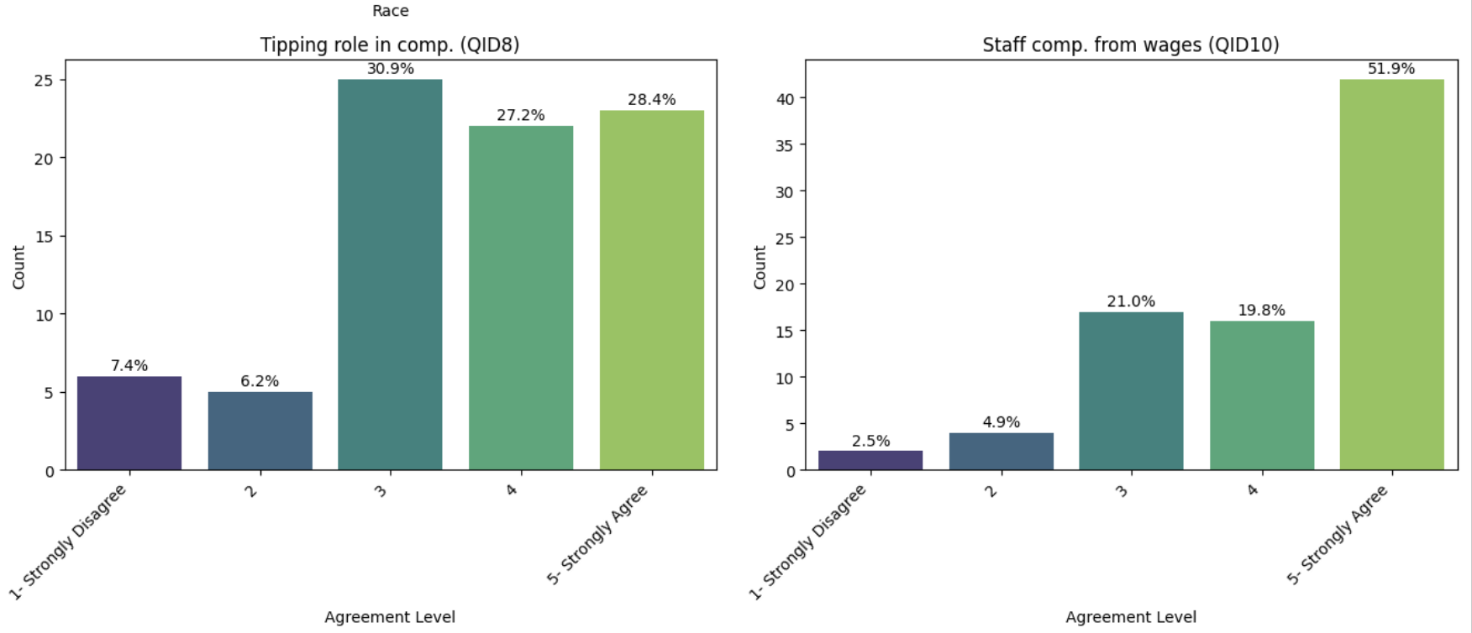
Cleaning
EDA
Randomization Check
Created Treatment indicator and merged control/treatment survey versions into a unified dataset
Missing values handled by listwise deletion when required
Demographic and behavior charts: age, race, years in U.S., dining frequency
Attitude results: respondents recognize tipping’s role, but many also support wage-based compensation
Survey duration check: most responses 20–180s; <20s treated as inattentive
Groups: 47 control (58%) vs 34 treatment (42%)
χ² test p = 0.149 → no significant imbalance
Covariates balanced (Age p = 0.837, Years in U.S. p = 0.440)
Notes:
Randomization check: p > 0.05 → no statistically significant difference between groups
Covariates balanced across groups

Slide 7
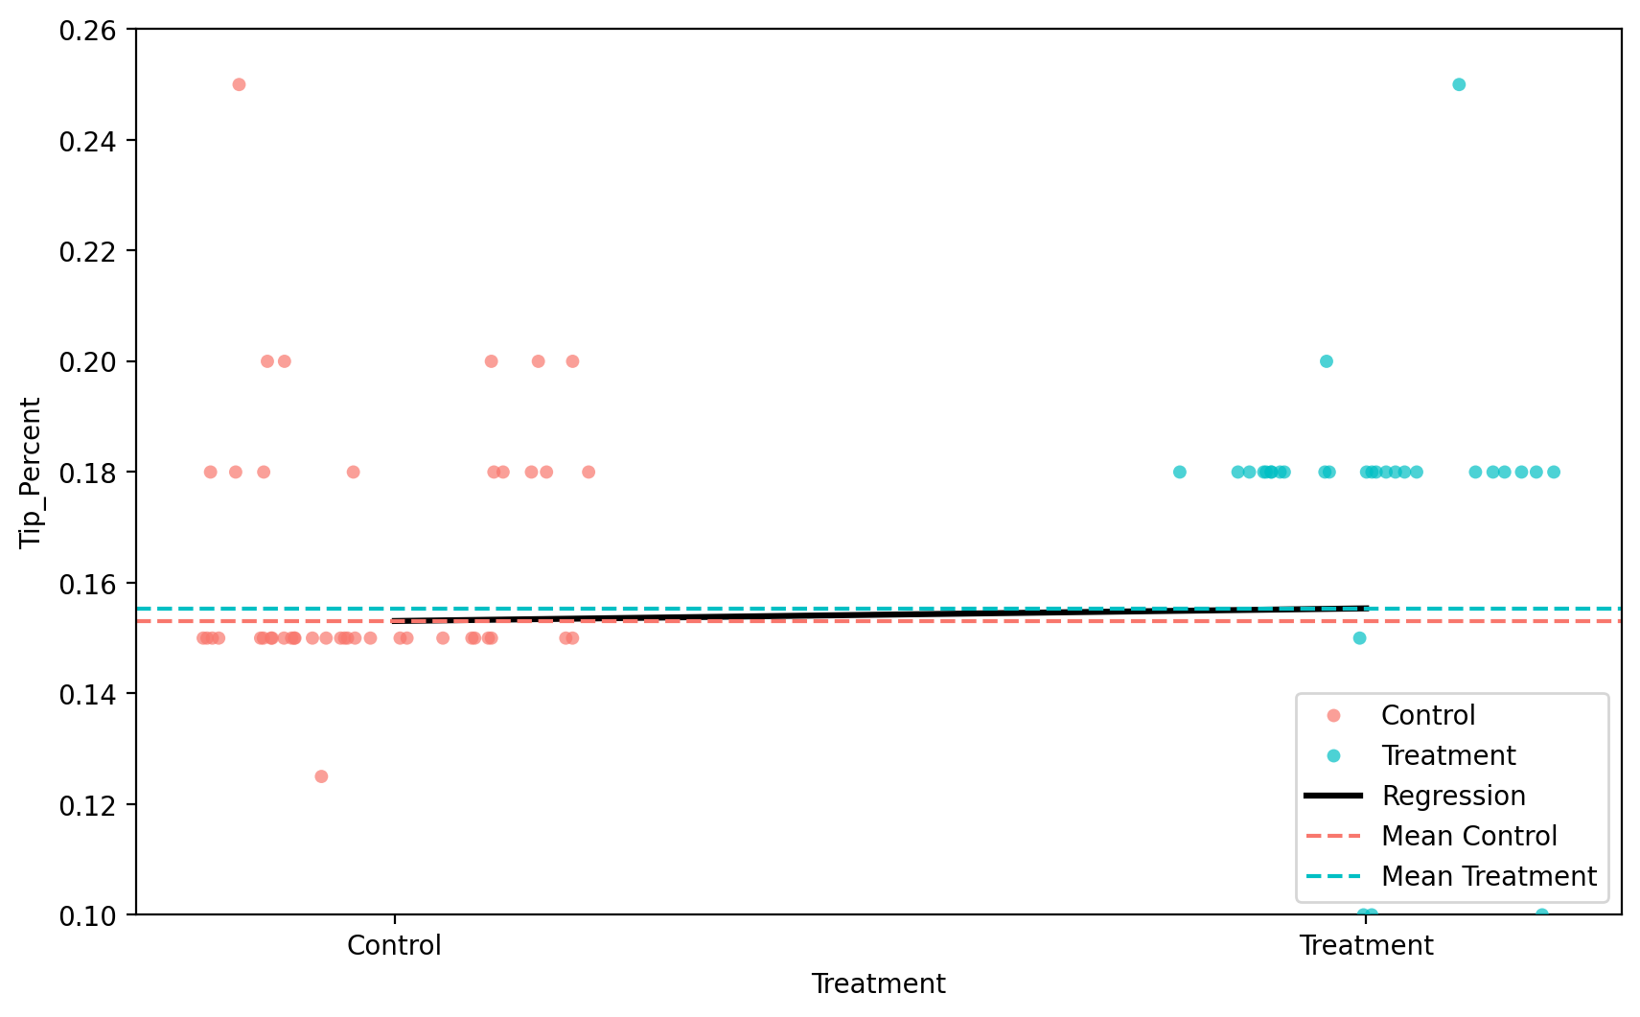
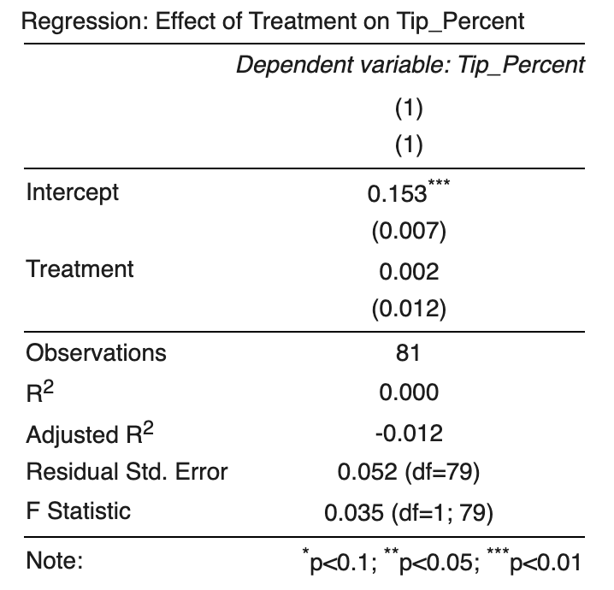
Methods & Results
Linear Regression detects 0.2 percentage point increase in tipping percentage for treatment vs. control
SE = 1.2 percentage point indicates insignificant results

Slide 8
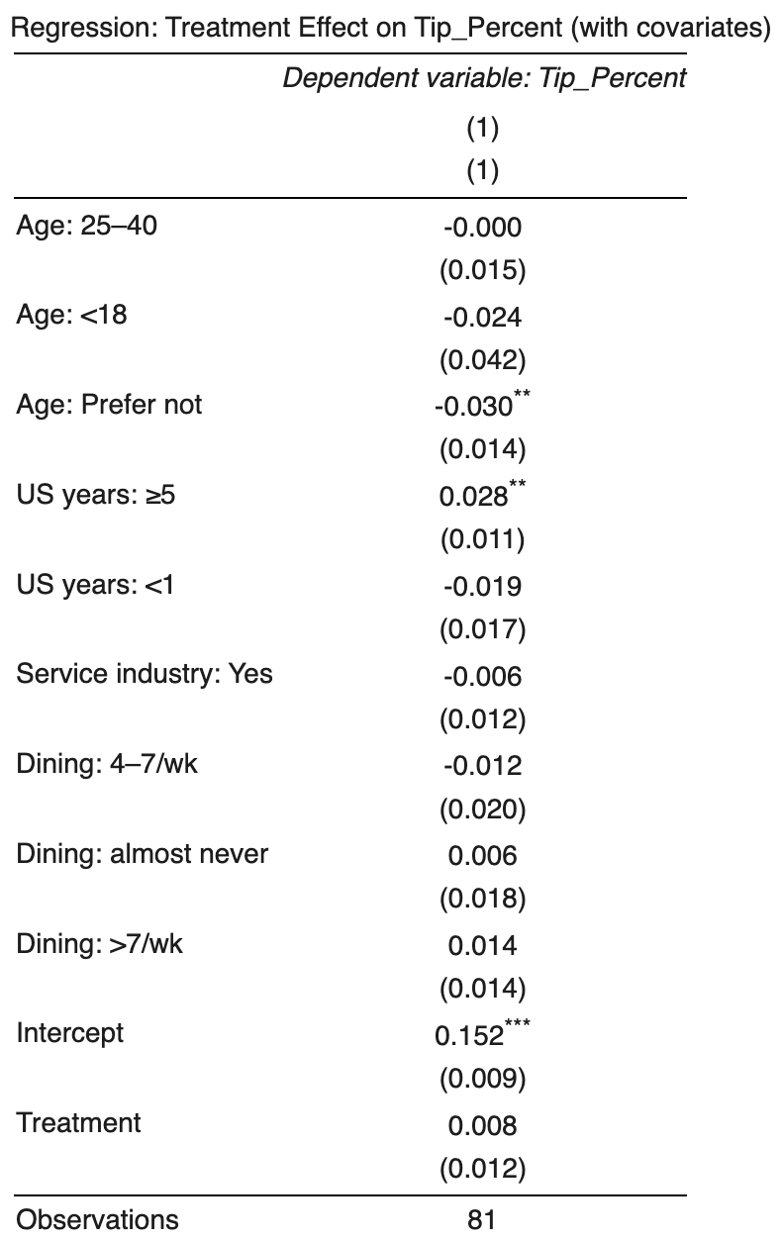
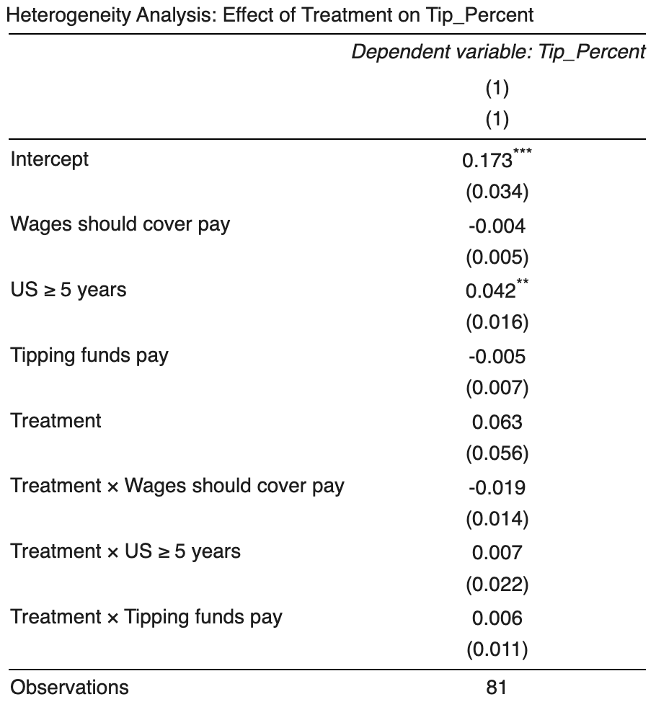
Methods & Results
Covariate Analysis:
Age, Service-Industry Experience, Dining Frequency, and Years Lived in the U.S.
Heterogeneity Analysis:
Years Lived in the U.S,
“Tipping plays a role in how restaurant workers are compensated”(1-5)
“Restaurant staff compensation should primarily come from wages paid by employers”(1-5)

Slide 9
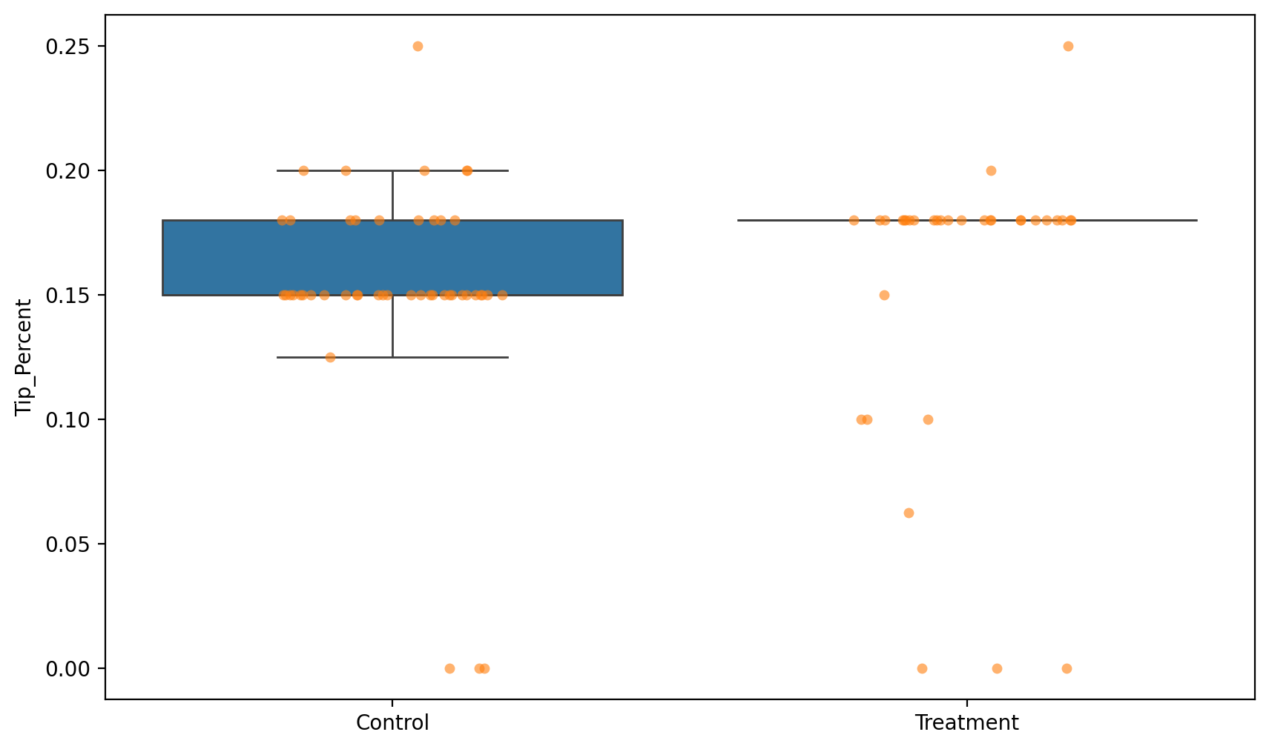
Interpretation
Participants usually pick the lowest preset tip option.
Treatment (18/20/25): most choose 18%; few choose 20% or 25%.
Raising the minimum to 18% shifts some 15% choosers up to 18%.
Others use “customise” to tip below 18% (sometimes very low), offsetting the increase.
25% may be too high; a smaller top option (e.g., 22%) could encourage more tips.
15%,18%,20%,
18%,20%,25%

Slide 10
Business Insight
Emphasize the importance of tips to employees income.
Option A
Result
Restaurants could run small-scale A/B tests on their own payment systems.
Simply increasing the available tipping percentage from 15% to 18% will have a limited impact on tipping behavior.
Option B
Provides multiple design options for the tips selection interface
Option C

Slide 11
Limitation
03
04
01
02
Simulated scenario difference
Limited sample size
The sample size we have right now may not be able to find small differences
People may interpret the simulated scenario differently, which could lead them to choose different tip amounts.
Sample Bias
Fake payment
Most of our data were collected from BU student.
People are not actually paying money for tips

Slide 12
Conclusions
Higher default tip suggestions did not significantly increase tipping
Tipping choices remain anchored around social norms (15–18%)
Interface design and behavioral nudges may be more effective than changing defaults
Future A/B testing in real payment systems can identify better tipping strategies

Slide 13
Thank You!
Any Questions?

